Slide 1
EU recommendations and legislation in water sector – WP1.2
DI Kurt Glock
University of Natural Resources and Life Sciences BOKU, Vienna
Meeting / 8th May 2019
This project has been funded with support from the European Commission. This publication reflects the views only of the author, and the Commission cannot be held responsible for any use which may be made of the information contained therein.

Slide 2
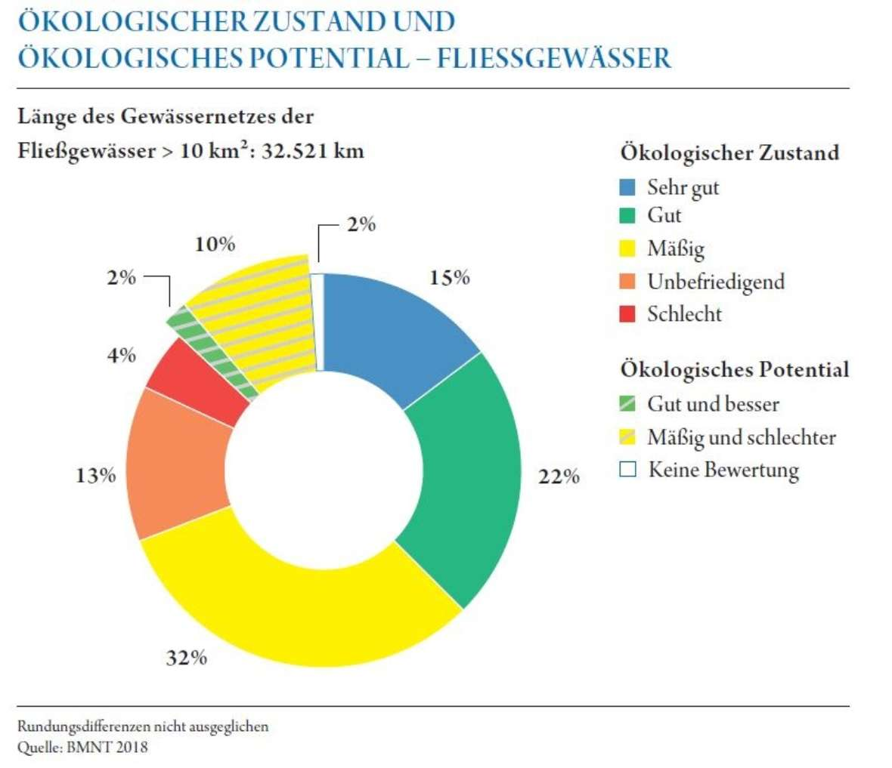
WP1.2 Analysis of EU innovations in water policy and EU recommendations and legislation in water sector
Analysis of EU legislation in WRM
(Water Framework Directive, EU Water Scarcity and Droughts Policy, Drinking Water Directive, etc.)
Implementation in
EU project partners countries
Roadmap for
further project initiatives
(e.g. preparing of trainings
for professionals)
Status of rivers
very good
good
moderate
poor
bad
Potential of rivers
good
moderate/poor
no info
Figure: Ecological status and
potential of rivers (>10km²) in Austria (BMNT, 2018)

Slide 3
Analysis of EU legislation in WRM
Water Framework Directive
Floods Directive
Drinking Water Directive
Groundwater Directive
Urban Waste-Water Treatment Directive
Industrial Emissions Directive
Renewable Energy Directive
Habitats Directive
Birds Directive
…

Slide 4
Water Framework Directive
“The purpose of this Directive is to establish a framework for the protection of inland surface waters, transitional waters, coastal waters and groundwater.”
Objectives:
Surface water
  Prevention of deterioration of the status of all surface water bodies.
  Enhancement and restoration of all water bodies to achieve a good surface water status, which is based on a good chemical and ecological status.
  Enhancement and restoration of all heavily modified water bodies to achieve a good surface water potential, which is based on a good chemical and ecological potential.
Groundwater
  Prevention of input of pollutants into groundwater and prevention of deterioration of the status of all groundwater bodies.
  Enhancement and restoration of all groundwater bodies to achieve a good groundwater status, which is based on a good chemical and quantitative status.
Protected areas

Slide 5
Water Framework Directive
Quality elements for the classification of ecological status of rivers
Second Session:
Talk by Beatrice Wagner

Slide 6
Water Framework Directive
The main aspects of the Water Framework Directive
Coordination within river basins
Development of river basin management plans
International coordination within river basin districts
Consideration of combined approach for point and diffuse sources
Public information and consultation

Slide 7
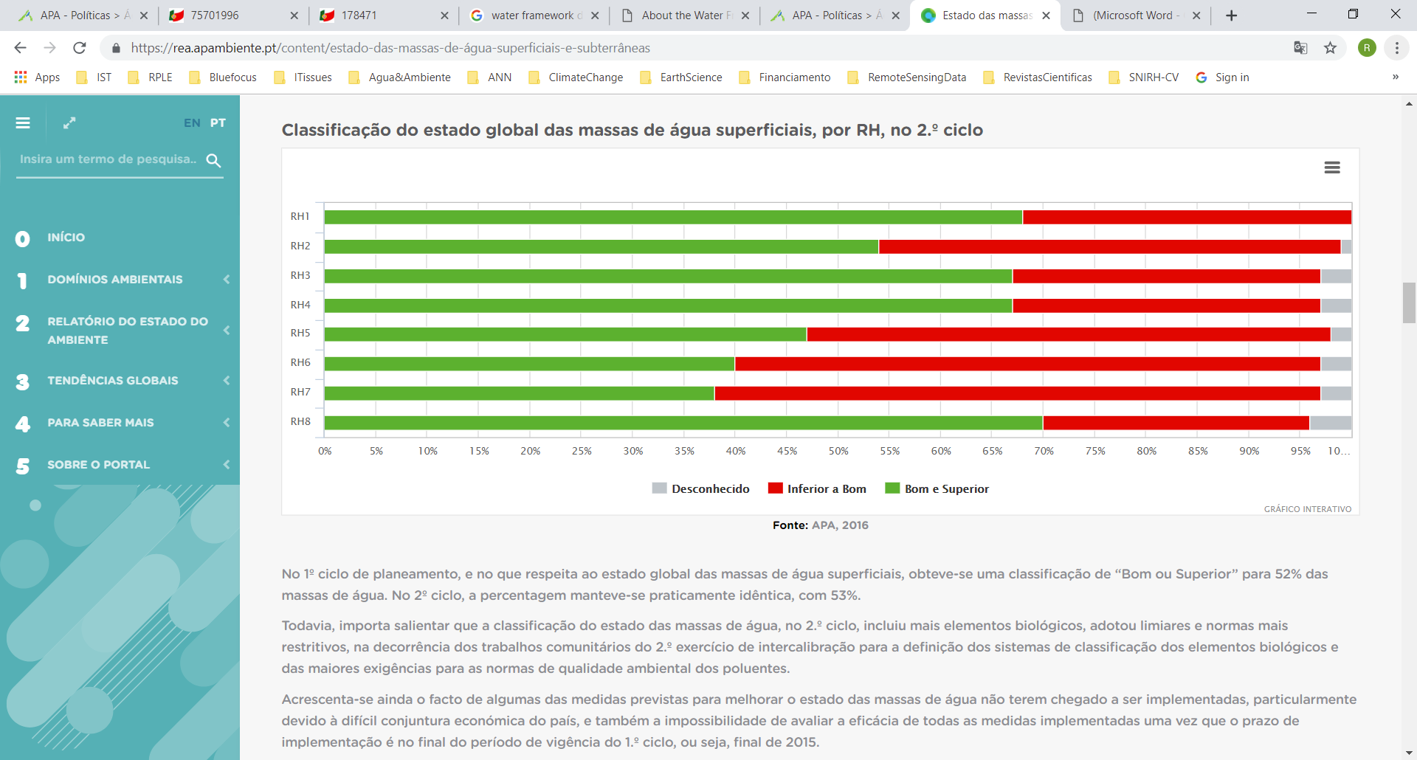
Water Framework Directive
Example Portugal
Differentiation into River Basins
River Basin Management Plans
1. 1990
2. 2016
3. 2022 (planned)
Status of surface water bodies in Portugal

Slide 8
Floods Directive
Introduction
“Floods have the potential to cause fatalities, displacement of people and damage to the environment, to severely compromise economic development and to undermine the economic activities of the Community.”
“Floods are natural phenomena which cannot be prevented. However, some human activities (such as increasing human settlements and economic assets in floodplains and the reduction of the natural water retention by land use) and climate change contribute to an increase in the likelihood and adverse impacts of flood events.”
“The purpose of this Directive is to establish a framework for the assessment and management of flood risks, aiming at the reduction of the adverse consequences for human health, the environment, cultural heritage and economic activity associated with floods in the Community.”

Slide 9
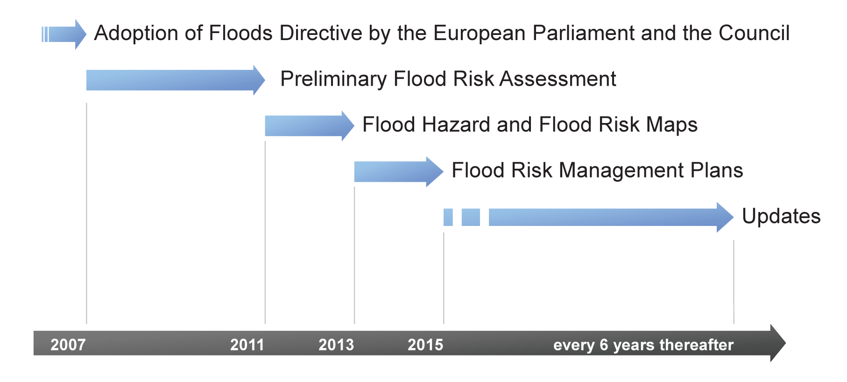
Floods Directive
Time table

Slide 10
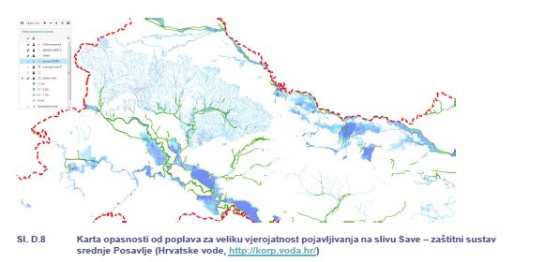
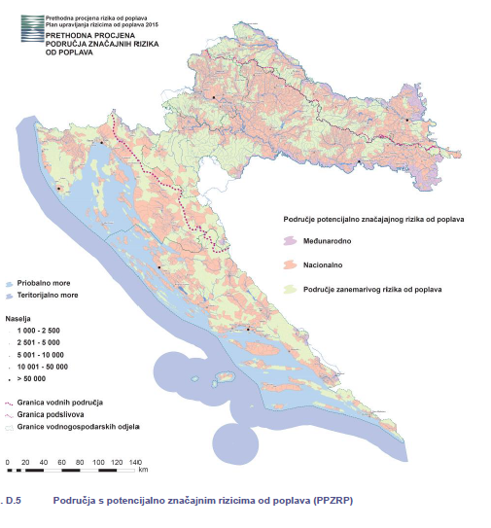
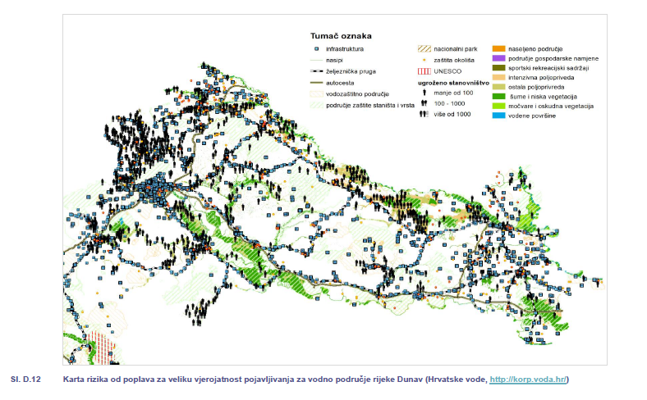
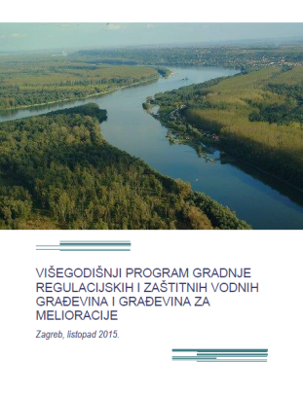
Floods Directive
Example Croatia
2a.) Flood Hazard Map for high probability of occurrence
1.) Preliminary Flood Risk Assessment
2b.) Flood Risk Map for high probability of occurrence
3.) Flood Risk Management Plans →

Slide 11
Urban Waste-Water Treatment Directive
Introduction
“This Directive concerns the collection, treatment and discharge of urban waste water and the treatment and discharge of waste water from certain industrial sectors.”
“The objective of the Directive is to protect the environment from the adverse effects of the abovementioned waste water discharges.”

Slide 12
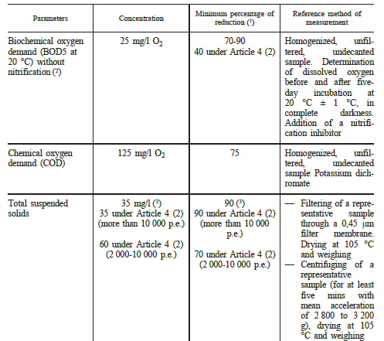
Urban Waste-Water Treatment Directive
Requirements for discharges from urban waste water treatment plants
Absolute values
Relative values

Slide 13
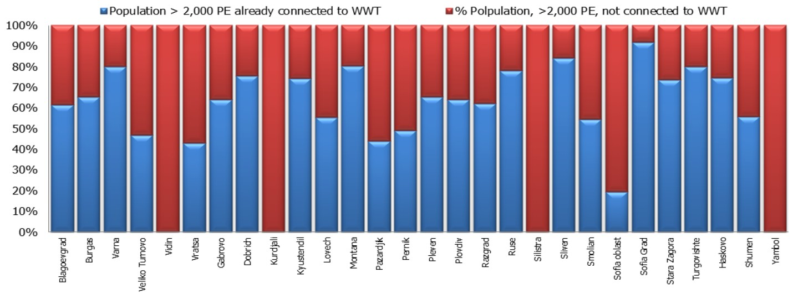
Urban Waste-Water Treatment Directive
Example Bulgaria
Cities without any waste-water treatment plant!
Difference between Sofia surrounding area and Sofia City
For the full implementation of the UWWTD requirements, the transitional period was
until 31 December 2014. Nevertheless the desired level of service and compliance is not achieved yet.

Slide 14
Drinking Water Directive
Introduction
“This Directive concerns the quality of water intended for human consumption.”
“The objective of this Directive shall be to protect human health from the adverse effects of any contamination of water intended for human consumption by ensuring that it is wholesome and clean.”
Quality standards
Point of compliance → Taps that are normally used for human consumption
Regular monitoring
Information and reporting

Slide 15
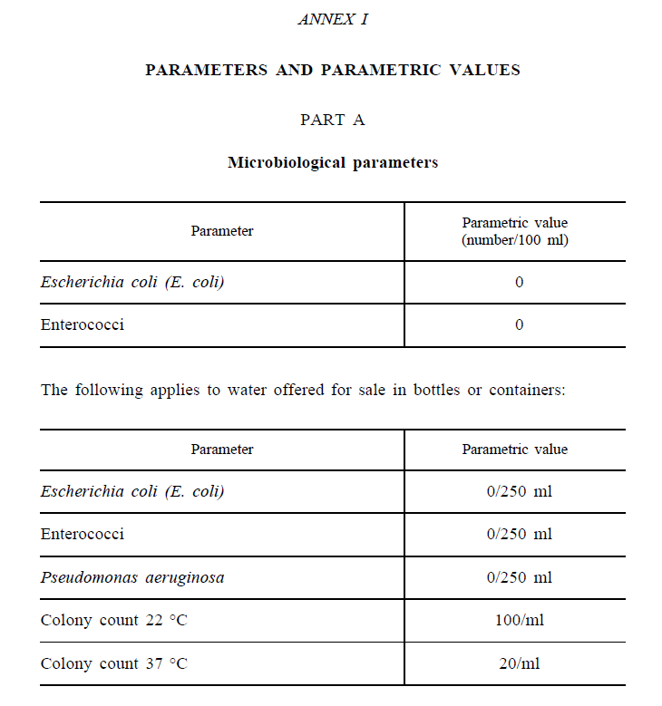
Drinking Water Directive
Quality standards
Distinguish between microbiological parameters, chemical parameters and indicator parameters

Slide 16
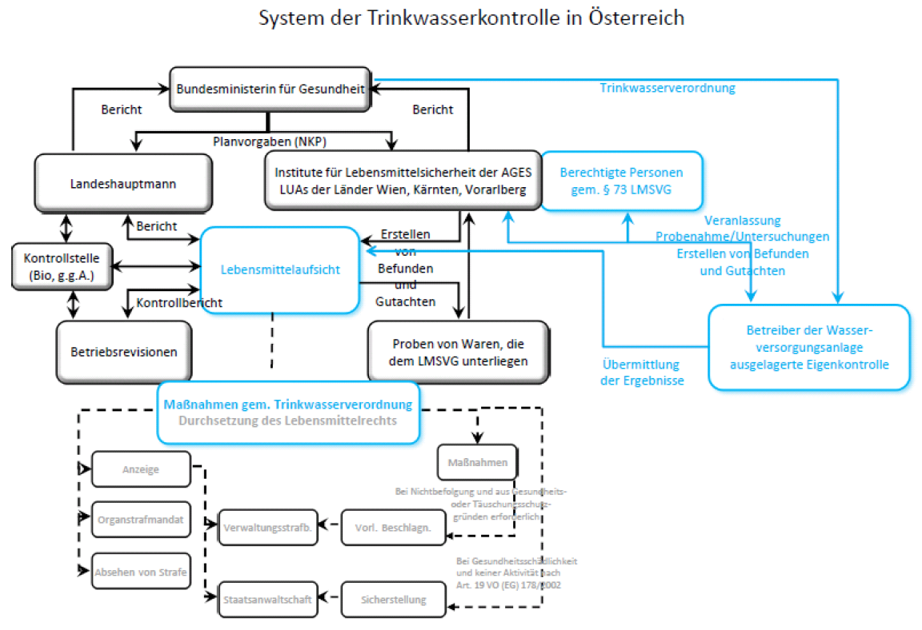
Drinking Water Directive
Example Austria
Monitoring system for drinking water
Government
Province
Self-control services

Slide 17
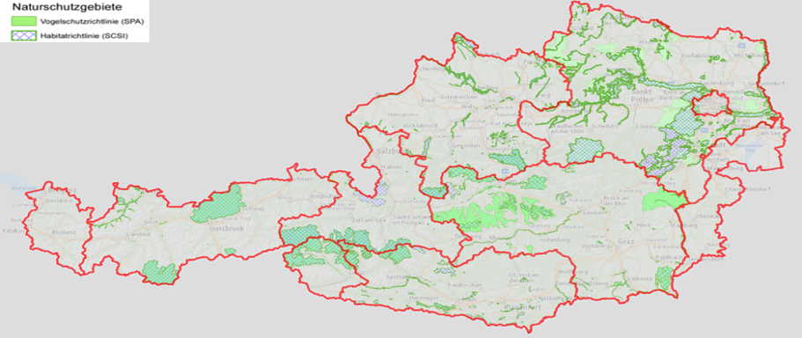
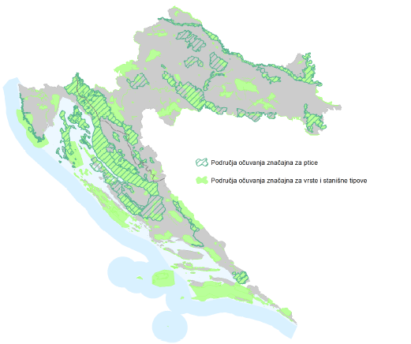
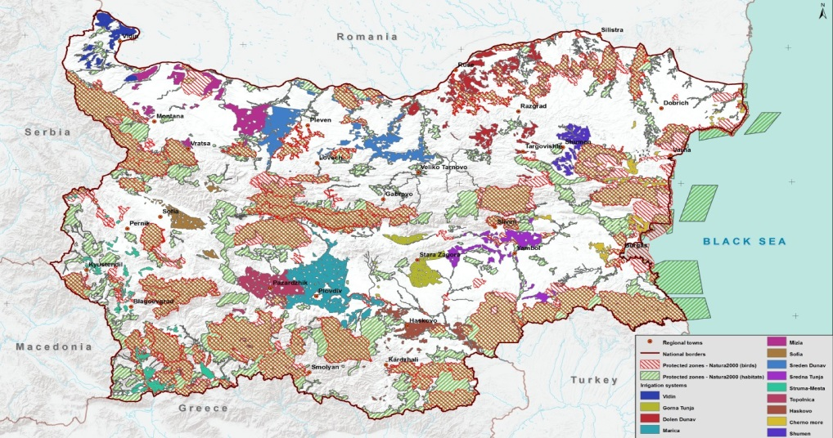
Additional Directives
Habitat and Birds Directive
“The aim of these Directives is the protection of species and habitats of listed species.”

Slide 18

Contact information
University of Natural Resources and Life Sciences Vienna (BOKU)
Department of Water, Atmosphere and Environment (WAU)
Institute of Hydraulic Engineering and River Research (IWA)
Find more about us in
http://www.wau.boku.ac.at/en/
Kurt Glock
Dipl.-Ing.
E-mail: kurt.glock@boku.ac.at
Michael Tritthart
Priv.-Doz. Dipl.-Ing. Dr.techn.
E-mail: michael.tritthart@boku.ac.at

